Slide 1
GCBASIC
PIC18FxxQ24
Part 11 - I2C Operations - Discovery

Slide 2
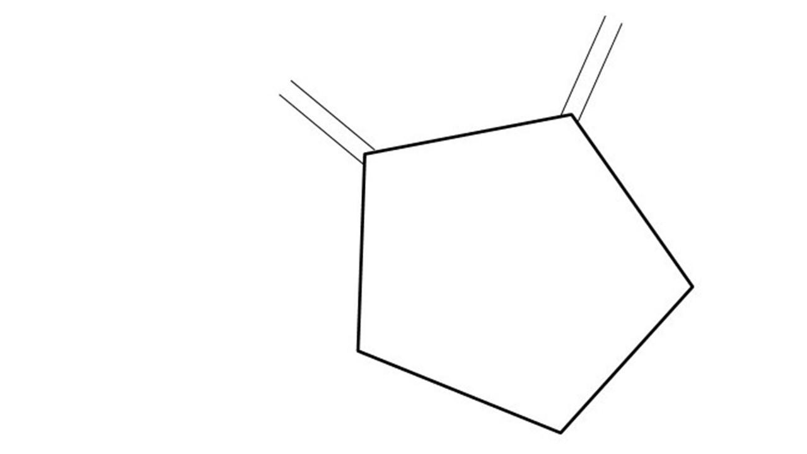
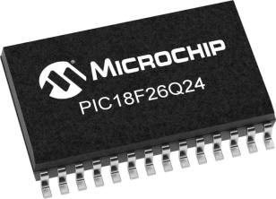
GCBASIC
PIC18FxxQ24
Part 11 - I2C Operations - Discovery

Slide 3
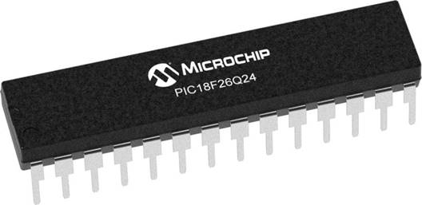
GCBASIC
Like and subscribe!

Slide 4
PIC18FxxQ24
PIC18-Q24 is a high performance PIC18
Digital and Analog peripherals
10-bit ADC
Multiple communication interfaces
Serial, I2C and SPI
PWM – CCP/PWM and 16Bit
Configurable Logic Cells
Multi voltage domains
The PIC18xxQ24 offers 28, 40 and 48-pin products in small footprint packages to support customers in a wide variety of applications.

Slide 5
Videos...
Install the hardware and make the board work – three LED programs
Make four LEDs flash in a sequence
Set the LEDs to represent the value of ADC
Sequence the LEDs with a delay using the value of ADC
Using an input to set the state of the LEDs
Using the reset switch
Using the switch, ADC – make the LEDs flash in a sequence with reverse
Using the serial to display values
Using the timer0 overflow, 8bit timer, 16bit timer to flash the LEDs
Using EEProm – showing values on the serial terminal, and more constants insights
Using I2C with serial to discover I2C devices
Using an I2C GCLD display
Using a SPI GCLD display
Using PWM, 7 ways, to dim the LEDS
Using an external interrupt to control an LED
Using storage within the chip – Progmem, SAF memory, EEPROM and DATA blocks
Using CLC
The GCBASIC tool chain
Assembly , alternatives assemblers and MPLAB-X
Summary

Slide 6
GCBASIC Compiler
GCBASIC Compiler
GCBASIC is an Open Source compiler for PIC and AVR microcontrollers
GCBASIC now supports the 18FxxQ24 chip family

Slide 7
Prerequisites
Assumes you have
Installed the GCBASIC software
Installed your programmer software
Test that you have the 18FxxQ24 attached
You have the 4 LEDs operating
You have a POT connected
You have SWITCHes connected
You have a USB/TTL converter
GLCD i2C device

Slide 8
I²C
I²C uses two bidirectional open collector or open drain lines pulled up with resistors
Serial Data Line (SDA)
Serial Clock Line (SCL)
Typical voltages used are +5 V or +3.3 V, although systems with other voltages are permitted

Slide 9
Hardware
Hardware
-------------------PORTA----------------
Bit#: -7---6---5---4---3---2---1---0---
IO: ----------------SW----------ADC--
----------------------------------------
-------------------PORTB----------------
Bit#: -7---6---5---4---3---2---1---0---
IO: ----------------LED-LED-LED-LED--
----------------------------------------
------------------PORTC-----------------
Bit#: -X---6---5---4---3---2---1---0---
IO: -^--TX------SCL-SDA--------------
-----VDDIO2-----------------------------
You must apply correct Voltage
------------------PORTE-----------------
Bit#: -----------------3---------------
IO: ----------------SW---------------
Prototype Board
Power 5v0
Programmer
LEDs & resistors
Switches & resistors
I2c device and circuit

Slide 10
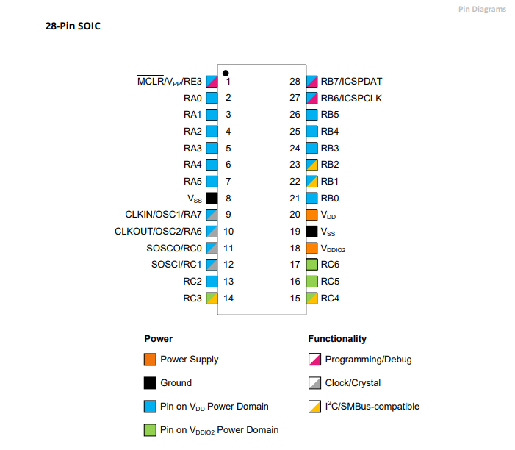
Power Domain – VDDIO2

Slide 11
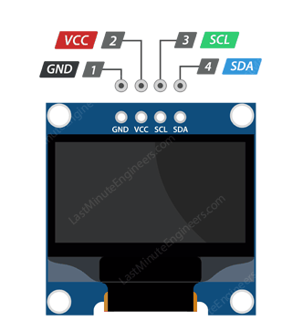
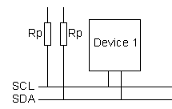
Setup
VCC
CLOCK
---------
SCL
DATA
---------
SDA

Slide 12
I2C sequence
i2cStart
i2cSend Address
i2cSend
Data
i2cStop
Start Condition:
Indicated by a high-to-low transition on the SDA line while SCL is high.
This signals the beginning of communication.
Send (Address):
Master sends the address of the slave device including by the Read/Write bit.
Slave responds with an Acknowledgment (ACK) bit.
Send (Data):
Master sends or receives data bytes.
Each byte is followed by an Acknowledgment (ACK) from the receiver.
Stop Condition:
Indicated by a low-to-high transition on the SDA line while SCL is high.
This signals the end of communication.

Slide 13
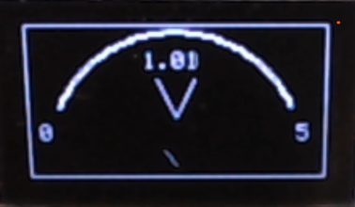
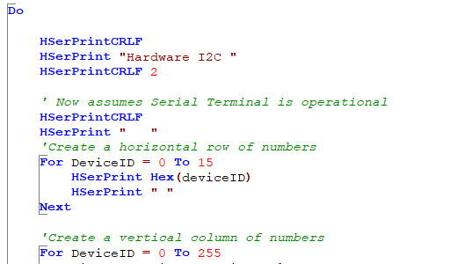
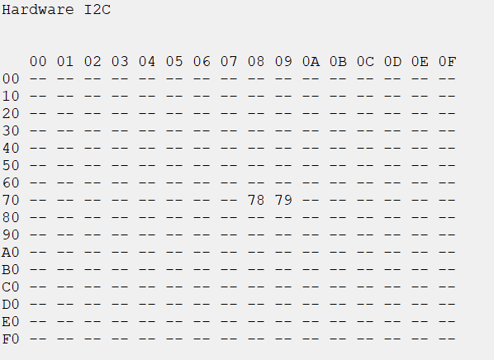
I²C

Slide 14
Lab
Examine the sample code
Using PPS select the I²C ports
Using PPS select the serial USART port
Set up the I²C
Review demonstrations and see the results
Demo number | Focus | Shows
180 & 190 | 128x32 & 128x64 capability demos | Primitives Memory usage & Transactions
200 | BMP converter | Converter
210 | Sprite | Expose buffer and custom I2C subroutine
220 | Voltmeter | Trig2places & Low level GLCD commands

Slide 16
Videos...
Install the hardware and make the board work – three LED programs
Make four LEDs flash in a sequence
Set the LEDs to represent the value of ADC
Sequence the LEDs with a delay using the value of ADC
Using an input to set the state of the LEDs
Using the reset switch
Using the switch, ADC – make the LEDs flash in a sequence with reverse
Using the serial to display values
Using the timer0 overflow, 8bit timer, 16bit timer to flash the LEDs
Using EEProm – showing values on the serial terminal, and more constants insights
Using I2C with serial to discover I2C devices
Using an I2C GCLD display
Using a SPI GCLD display
Using PWM, 7 ways, to dim the LEDS
Using an external interrupt to control an LED
Using storage within the chip – Progmem, SAF memory, EEPROM and DATA blocks
Using CLC
The GCBASIC tool chain
Assembly , alternatives assemblers and MPLAB-X
Summary

Slide 17
GCBASIC
PIC18FxxQ24
Part 11 - I2C Operations - Discovery

